Slide 1

Week 1 Lab – Getting Oriented in JASP
GES 408/608
Notes:
How this lab will work is it’s mostly self-paced, but I will have some check-ins where I will explain some key things. Just call me over if you have a question, and of course you can team up with your classmates and help each other!!

Slide 2
The Week 1 Lab file is in BlackBoard
It is a text document that has all of the basic instructions on it.
Start by opening Jasp and clicking around!
Then go ahead and start on the data entry vs. importing section.
There is a separate assignment submission portal in the Week 1 folder for when you finish at the end!

Slide 3
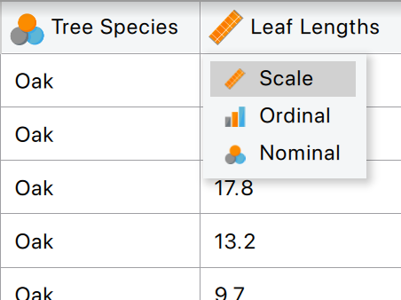
3 Types of Data in JASP
Scale is for numerical variables (can be continuous or discrete).
Categorical variables have possible values called levels, and they can either be ordinal or nominal.
Nominal variables do not have a natural ordering.
Ordinal variables do have levels with a natural ordering (think age groups: 15-20, 21-25, etc.)

Slide 4
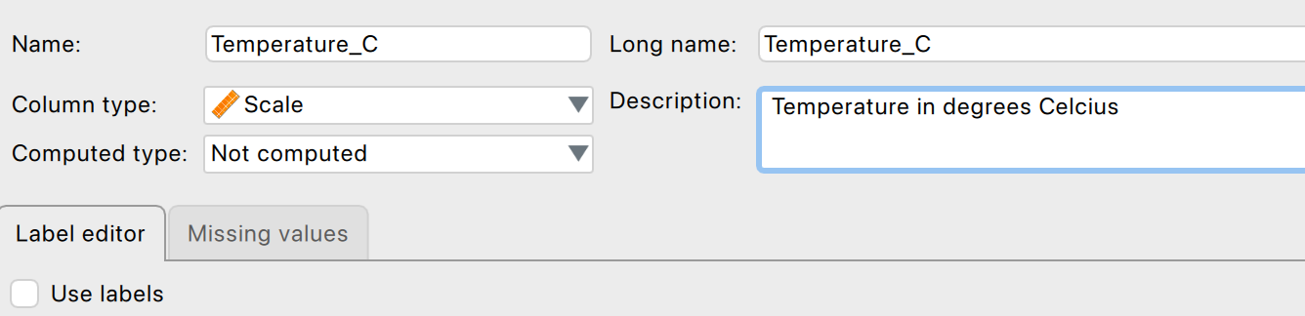
You can describe your data for record-keeping purposes
Notes:
Optional, but can be useful!

Slide 5
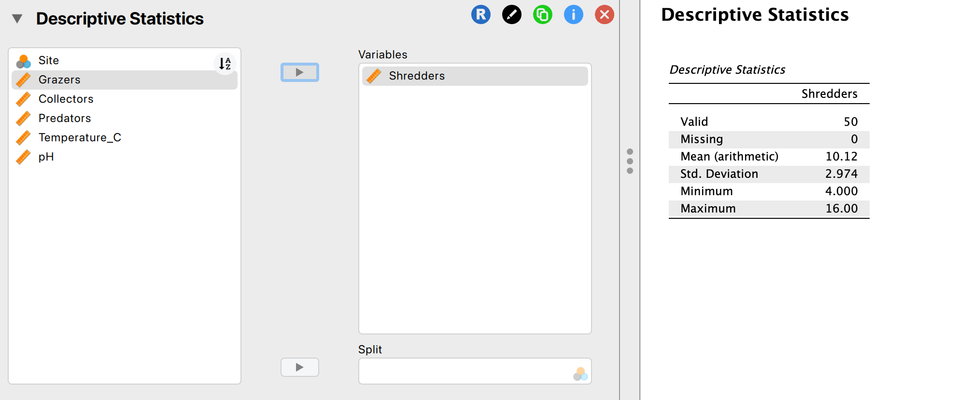
Working in JASP
Notes:
Move your variables from the left side (storage) to the right side (using) with the arrow keys or drag/drop

Slide 6
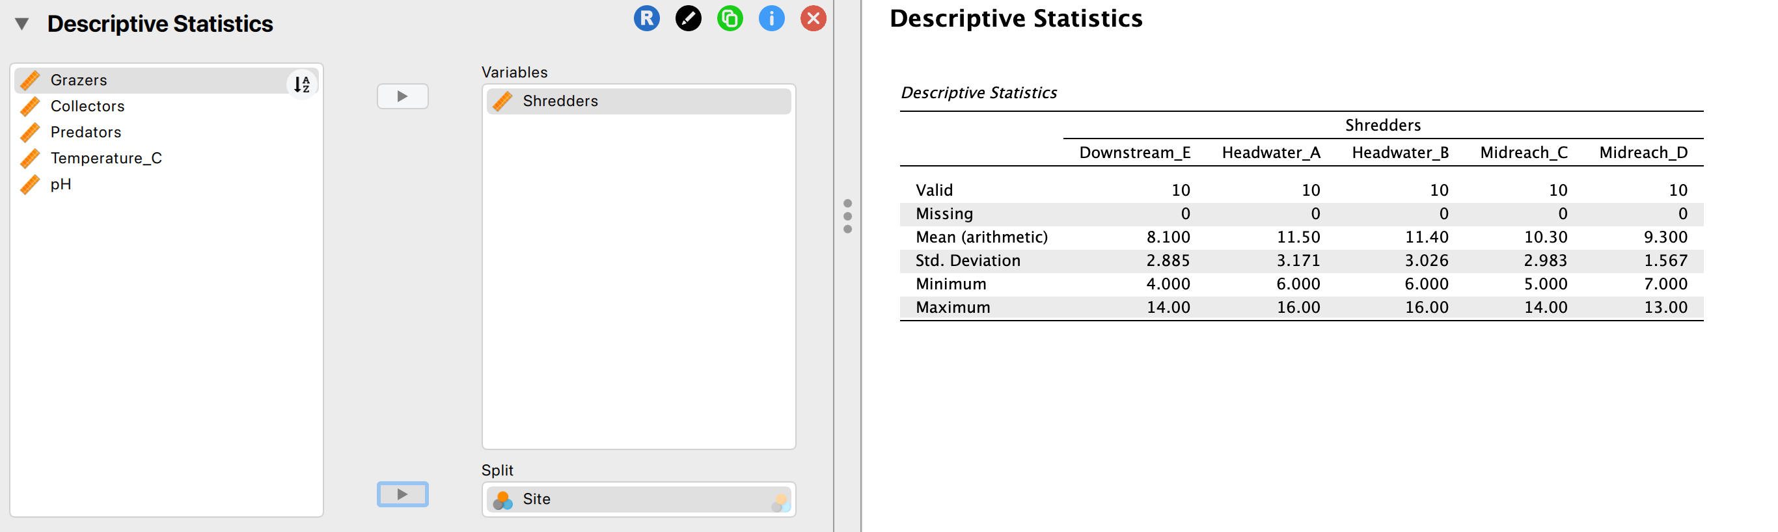
Working in JASP
Notes:
Split by a nominal variable – do the statistics on the shredders, but separate out each site!

Slide 7
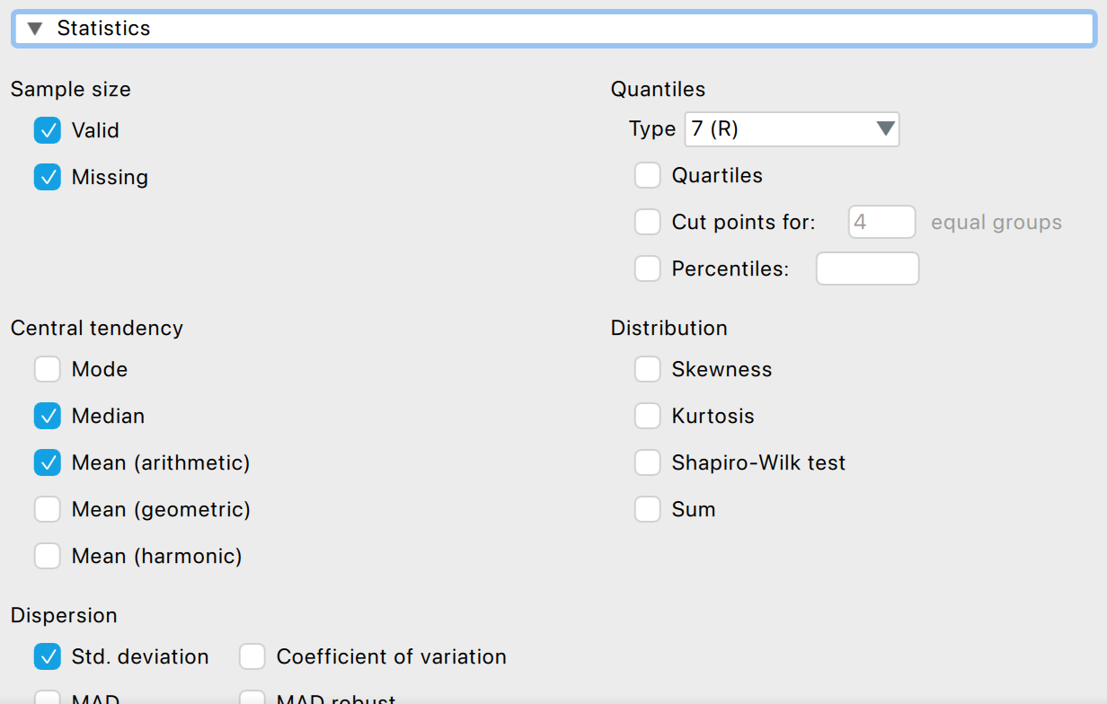
What results do you want?
Notes:
Below where you move your variables around, you can change up what the results show you, and there are options for different plots below this.

Slide 8
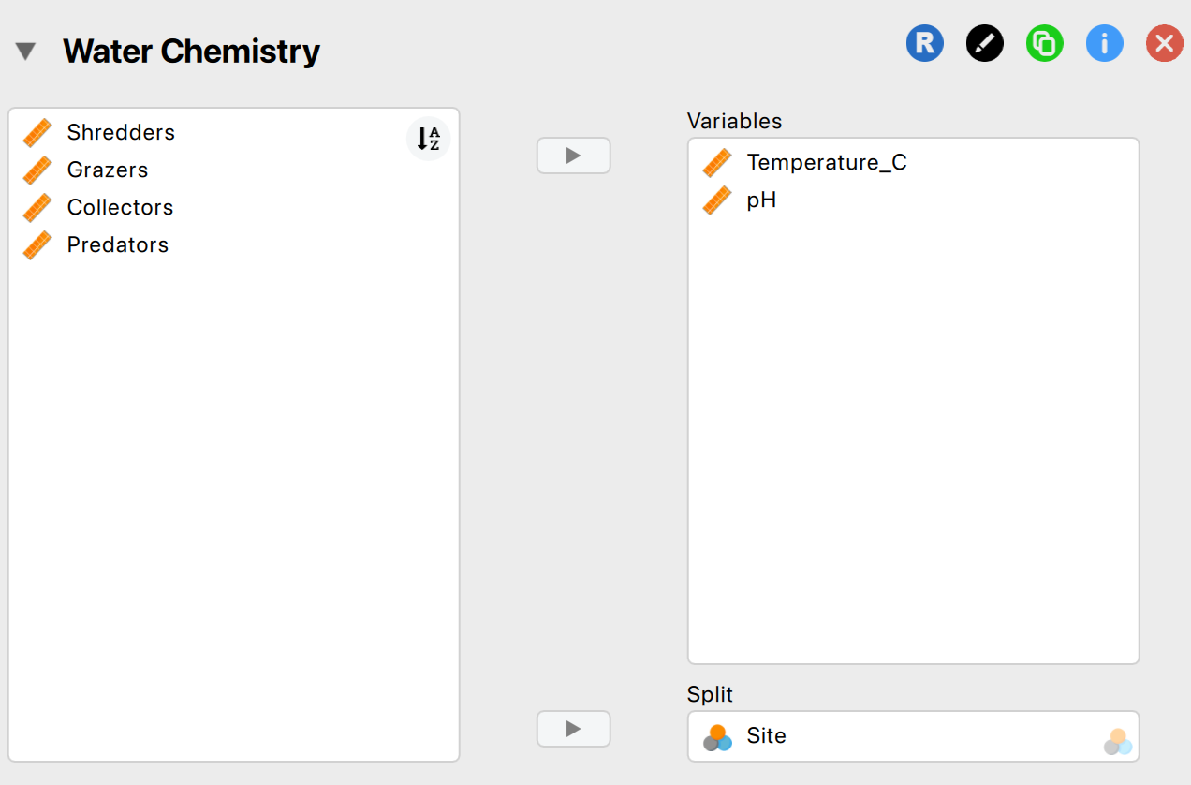
You are able to run separate analyses and rename each one!
Notes:
If you click on the descriptive statistics button on the top menu bar again, it opens up a separate analysis dropdown for you. You can have a bunch of these open, and can rename them to help keep organized.

Slide 9
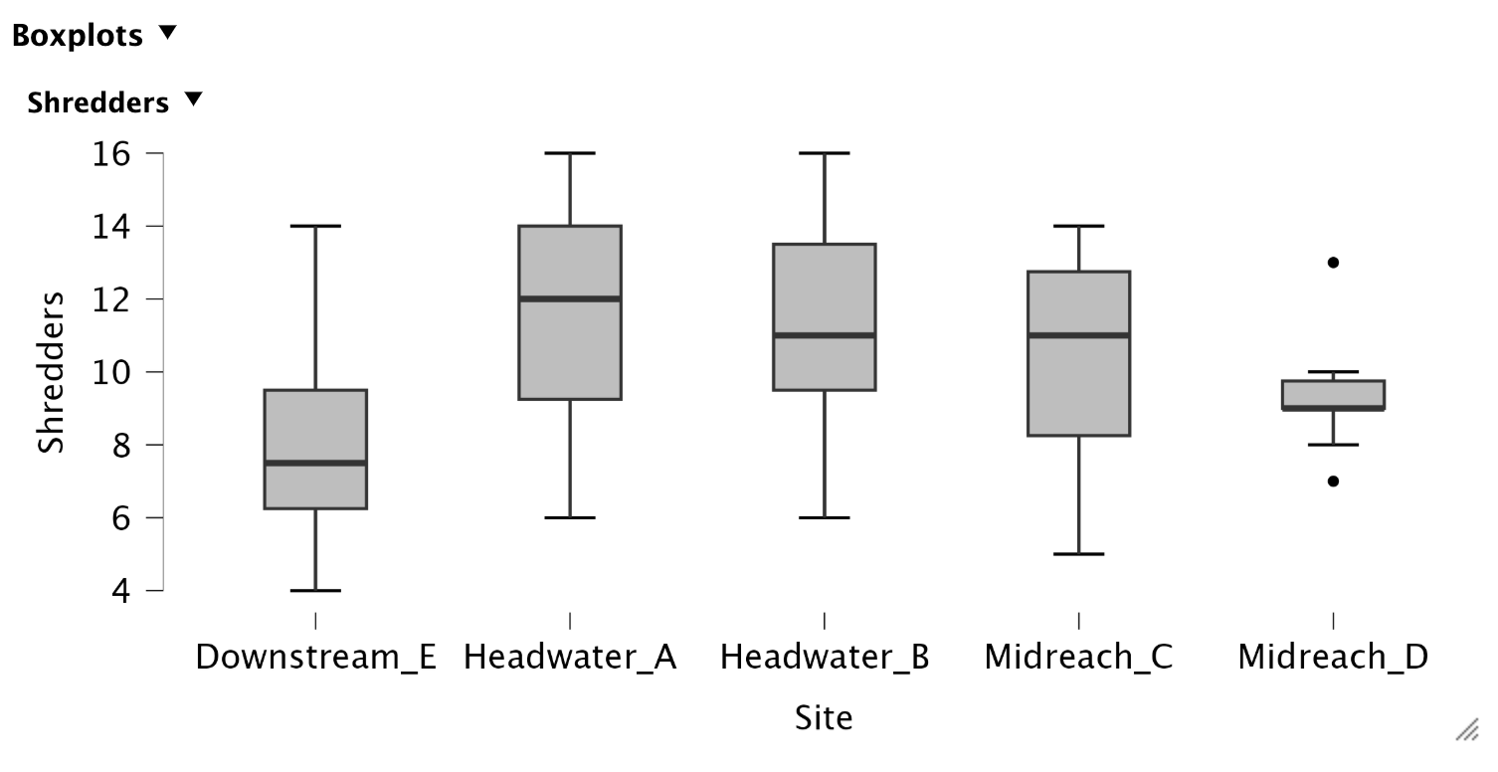
You can adjust the size of your plots!
Notes:
Pull this little corner triangle if your plots seem squished together.

Slide 10
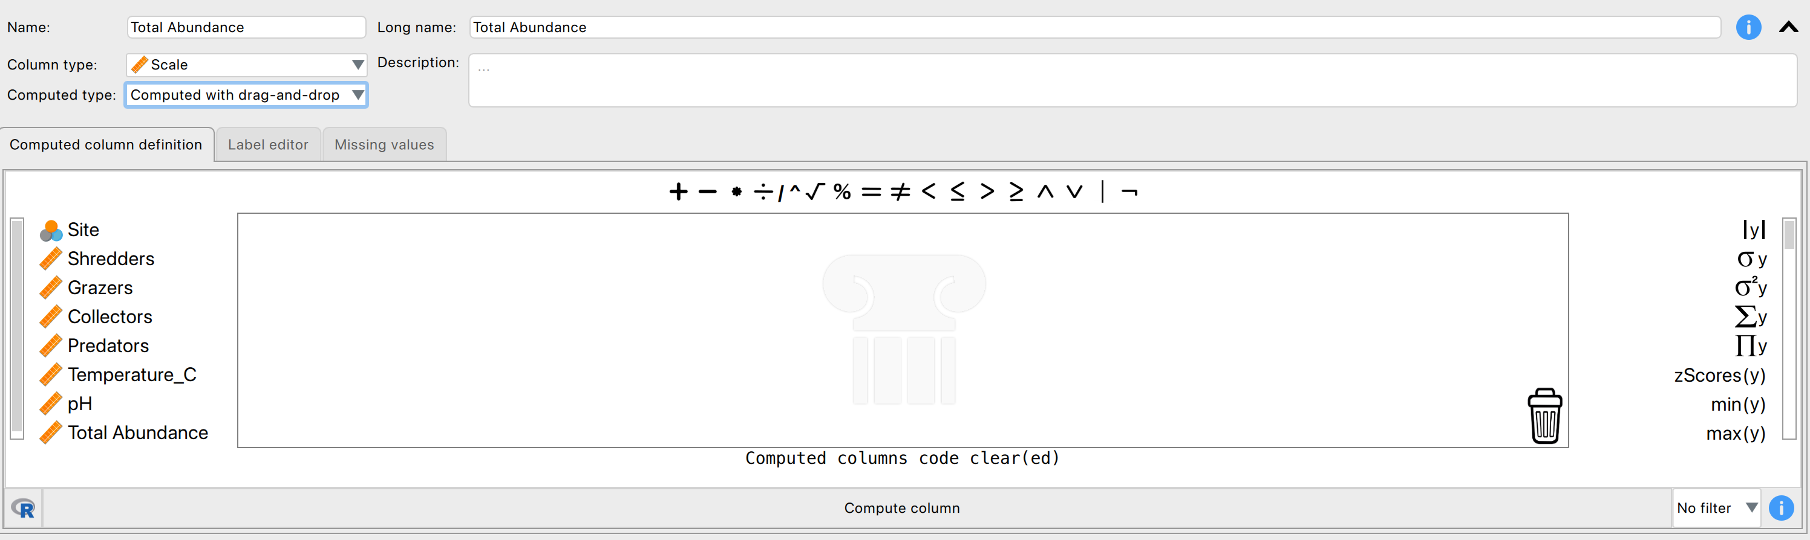
You can compute columns – this will help with relative abundance (and other things in the future)
Notes:
If you add a column on to your data, you can name it and there are options for computing the column based on other columns.
You can compute it with R code if you know how, or there is a drag/drop function where you click on the column you want the actions to be performed by. For instance, you can add two columns together so your new column is the sum of those two columns.

Slide 11
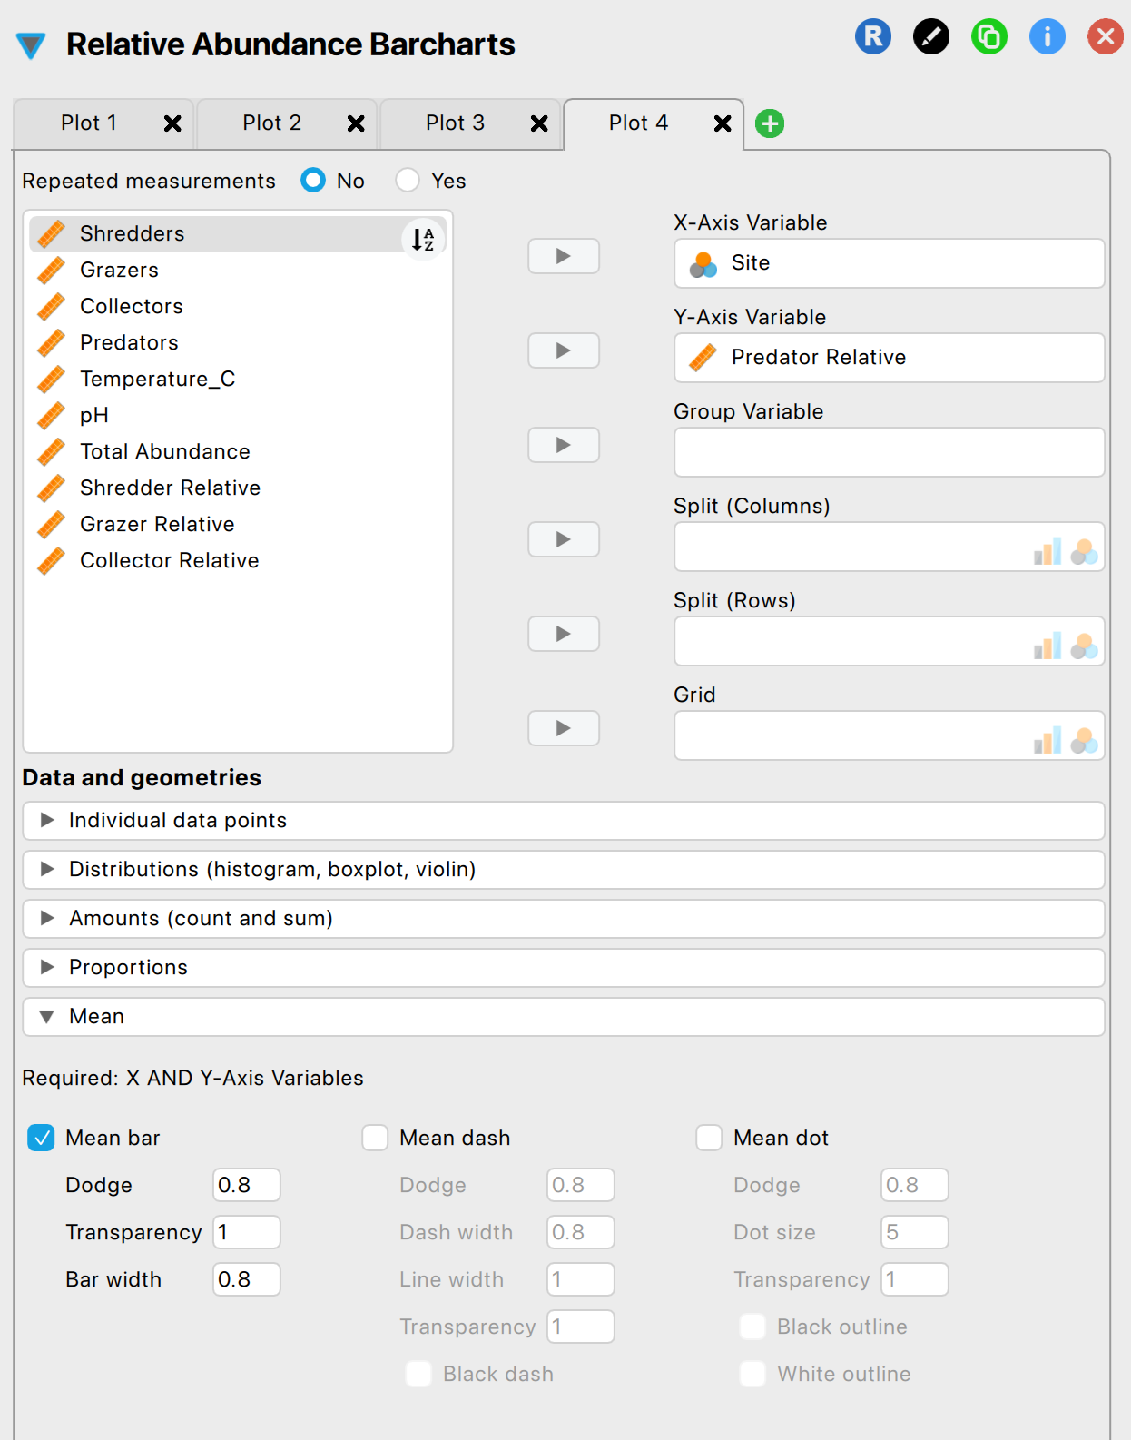
There is a plot builder function – utilize this for creating more specific plots!
Notes:
The plot builder function is something you can use to get more specific with the plots that you want! There are lots of options, but keep it simple for today.

Slide 12
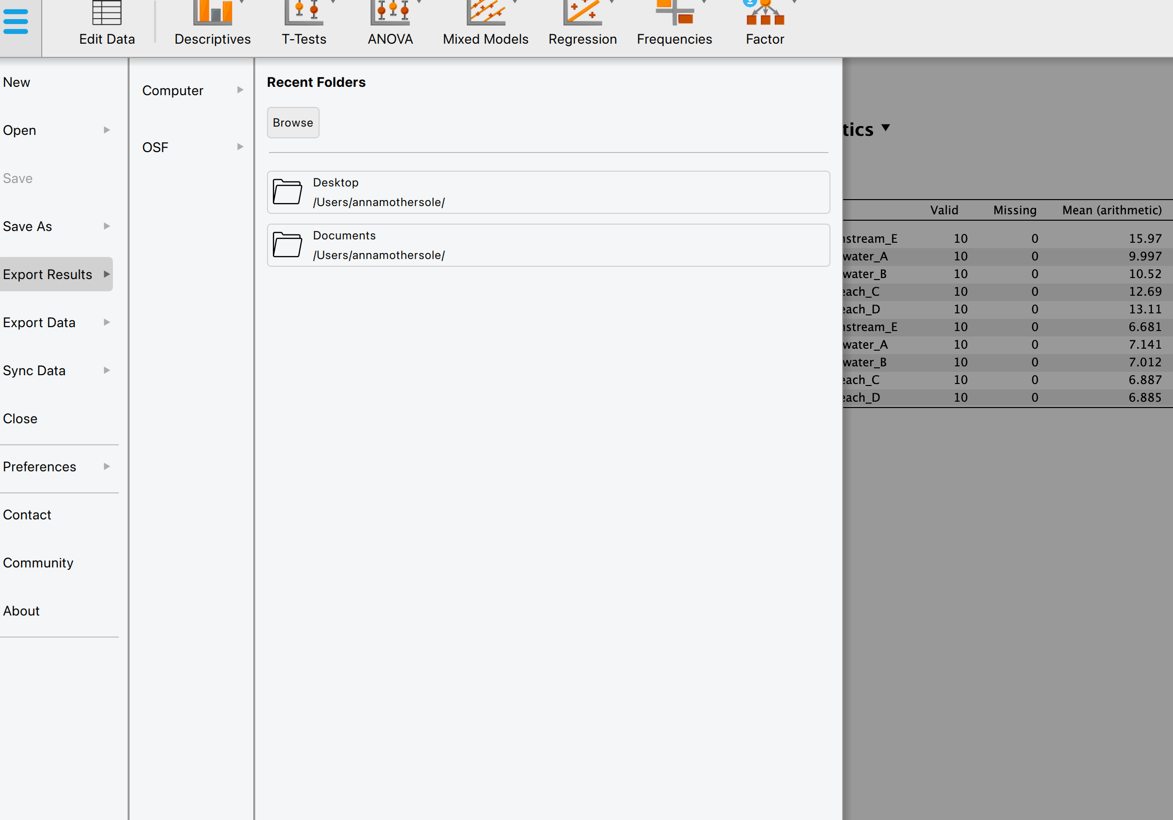
Exporting your results
Notes:
Go through the main menu to export your results, as this gives you the best options for it.

Slide 13

The assignment for this lab is due at 11:59PM on Sunday 08/30!
If you don’t finish in class, you have some time at home as needed.

